Slide 1
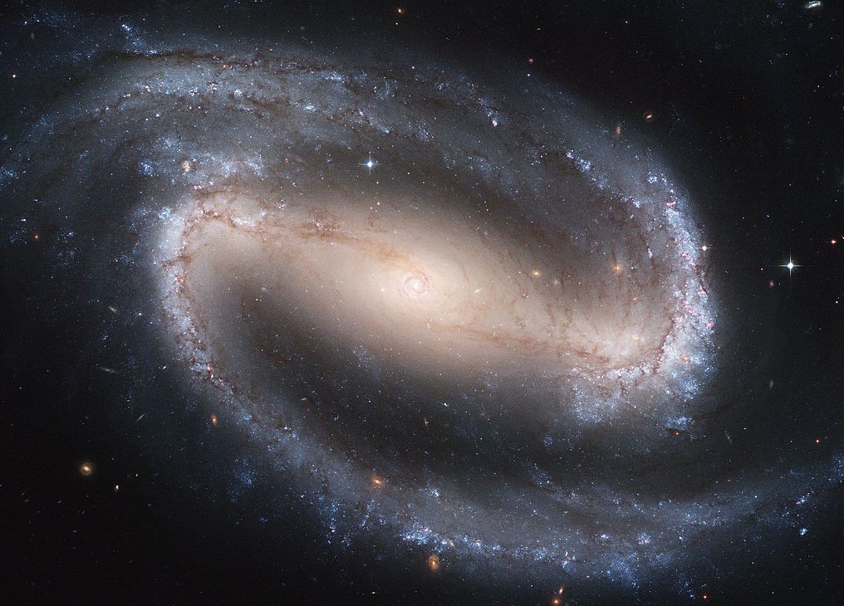
Modern Science and Christian Religion
2 – A First Cause: The Chicken, the Egg and the Big Bang

Slide 2
Revision !
The heavens proclaim the glory of God and the firmament shows forth the work of his hands.
Ps 18(19):2
Ever since the creation of the world God’s invisible nature, namely, his eternal power and deity, has been clearly perceived in the things that have been made.
Rom 1:20
In the beginning was the Word [Logos], and the Word was with God, and the Word was God. He was in the beginning with God; all things were made through him, and without him was not anything made that was made.
Jn 1:1-3

Slide 3
Arguments for the Existence of God
Cosmological
this week
Design
next week
Also
Ontological
From the human person
From the claims of revelation
for another time

Slide 4
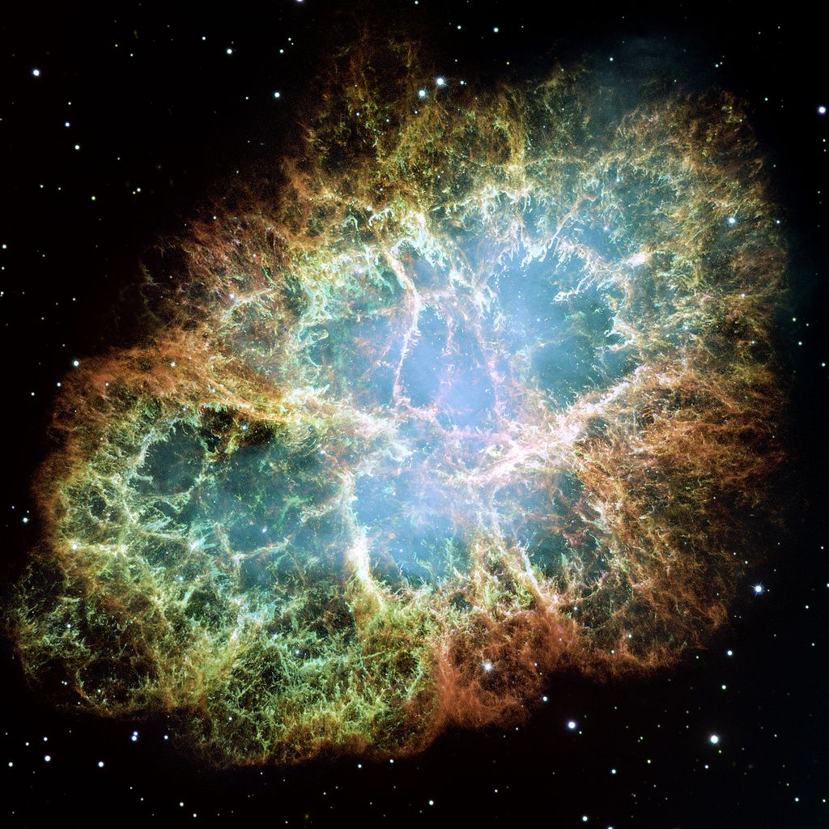
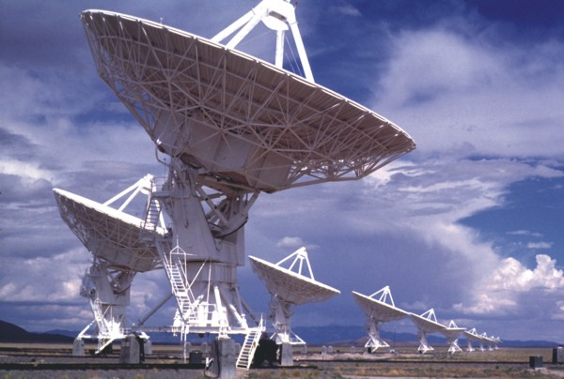
Cosmological Argument
We observe things that need explaining
that’s why we do science
They are “contingent”
They need a cause
They need a First Cause / Uncaused Cause

Slide 5
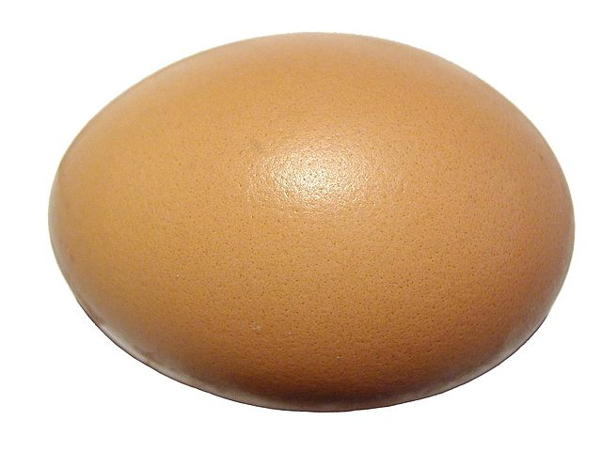
Infinite Regress?
?

Slide 6
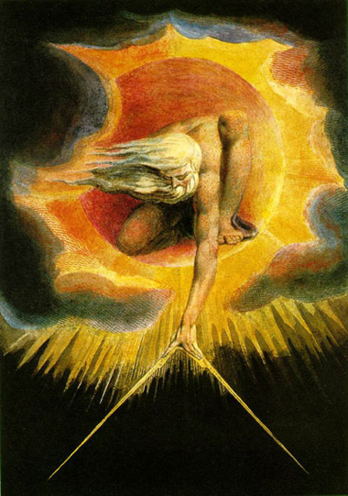
Who made God?
?

Slide 7
Why is there Something rather than Nothing?
Either
Everything-that-exists is caused by something else
Or
Everything-that-exists causes itself
Or
Something exists which does not need to be caused

Slide 8
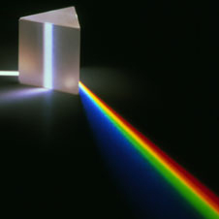
Arguments from Modern Science
Everywhere science applies, things need explaining: reasons & causes

Slide 9
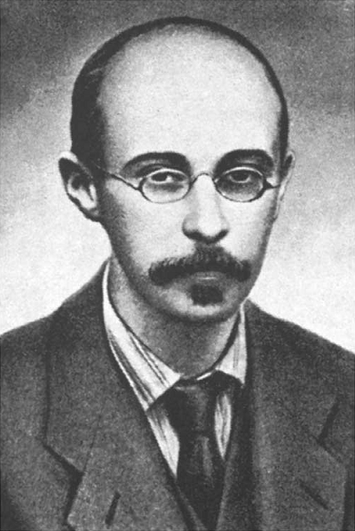
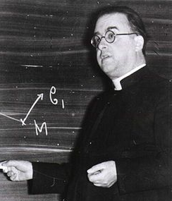
The Big Bang
Explosion of matter, radiation, space and time
13,800,000,000 years ago
Theory
Einstein (1915)
Friedmann (1922)
Lemaître (1927, 1931)

Slide 10
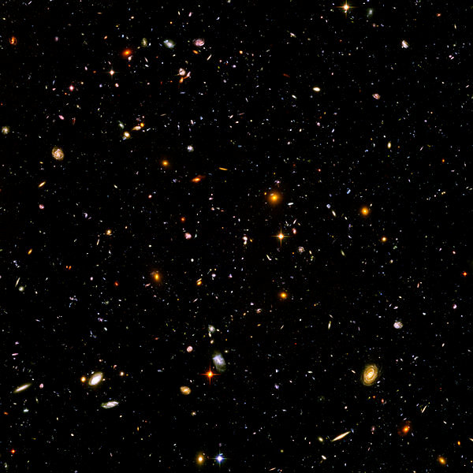
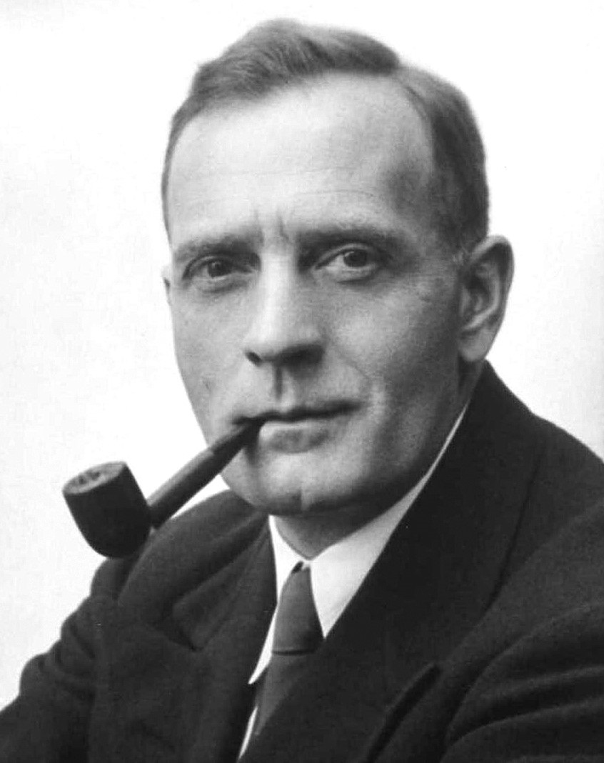
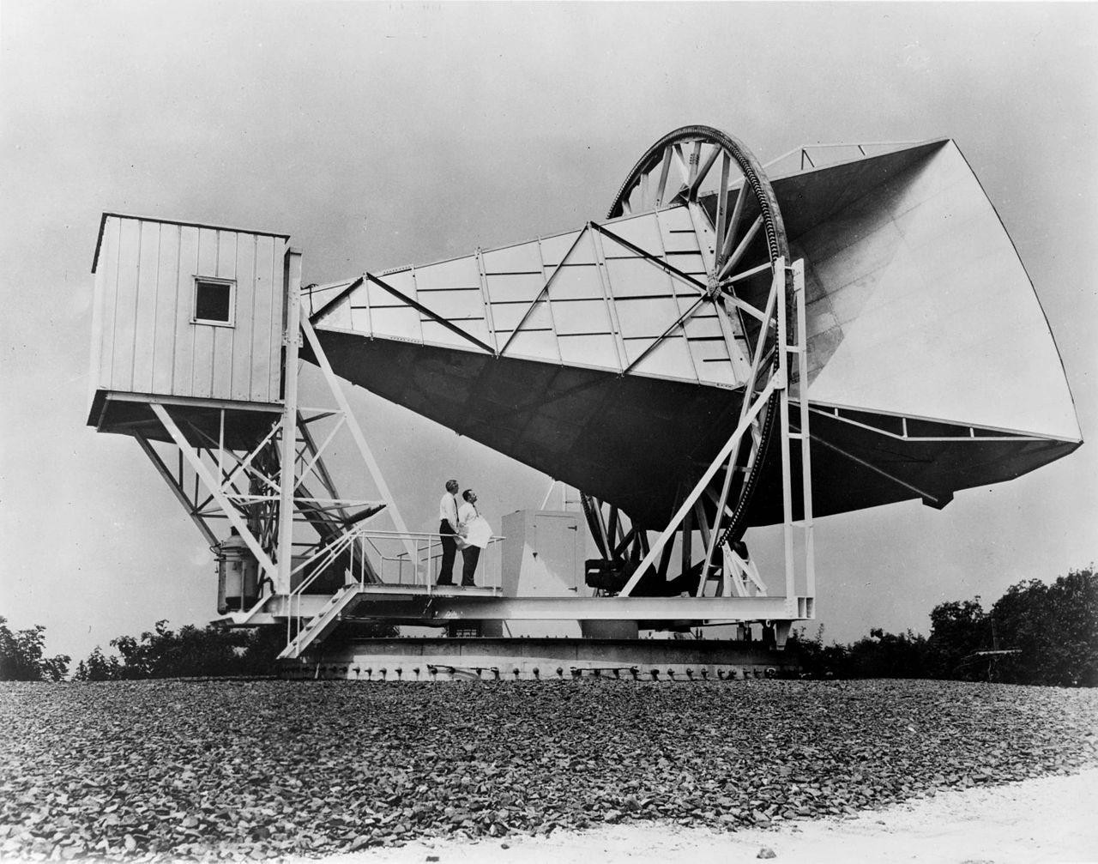
Big Bang – The Evidence
Recession of galaxies
Hubble (1929)
Cosmic microwave background
Penzias and Wilson (1965)
Primordial nucleosynthesis

Slide 11
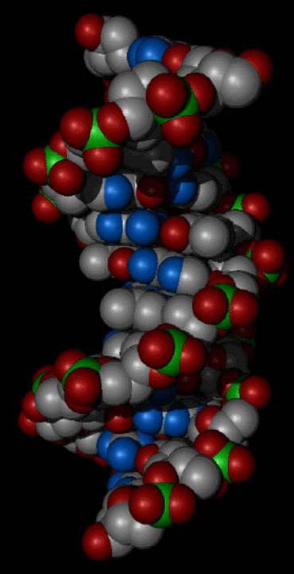
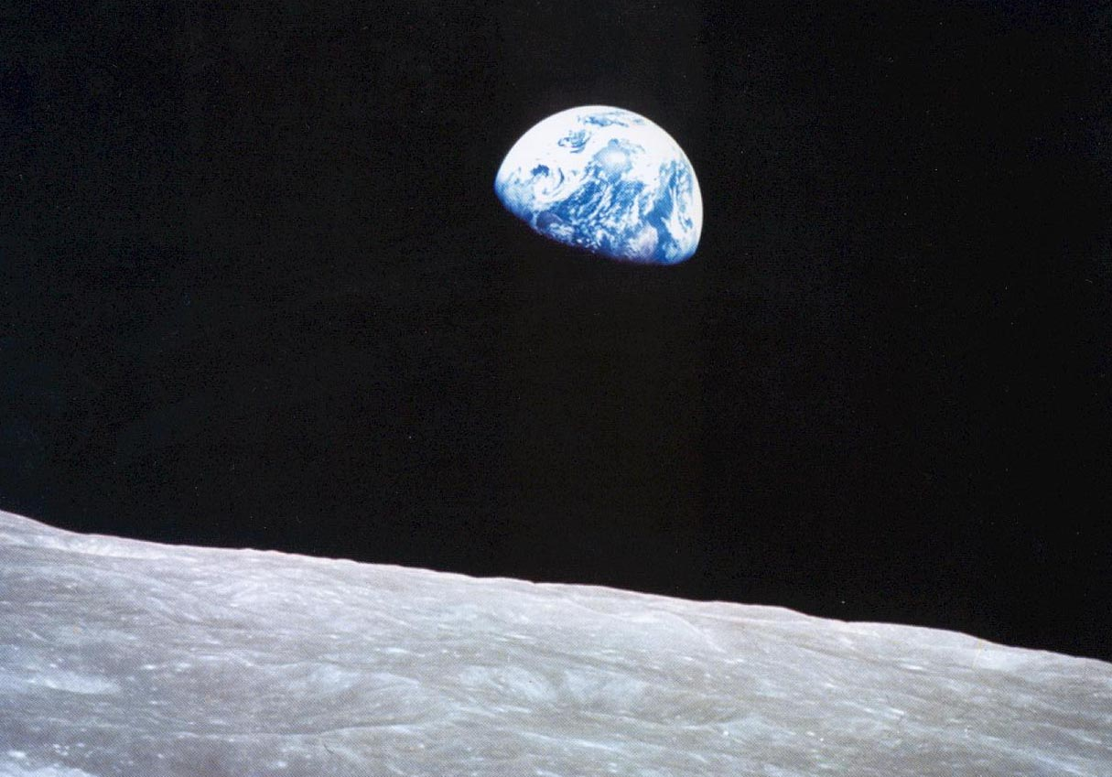
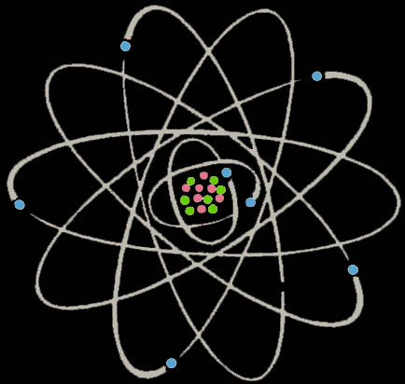
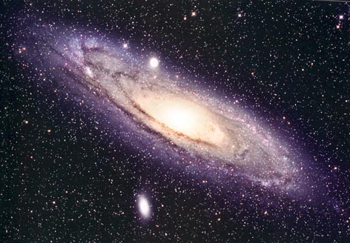
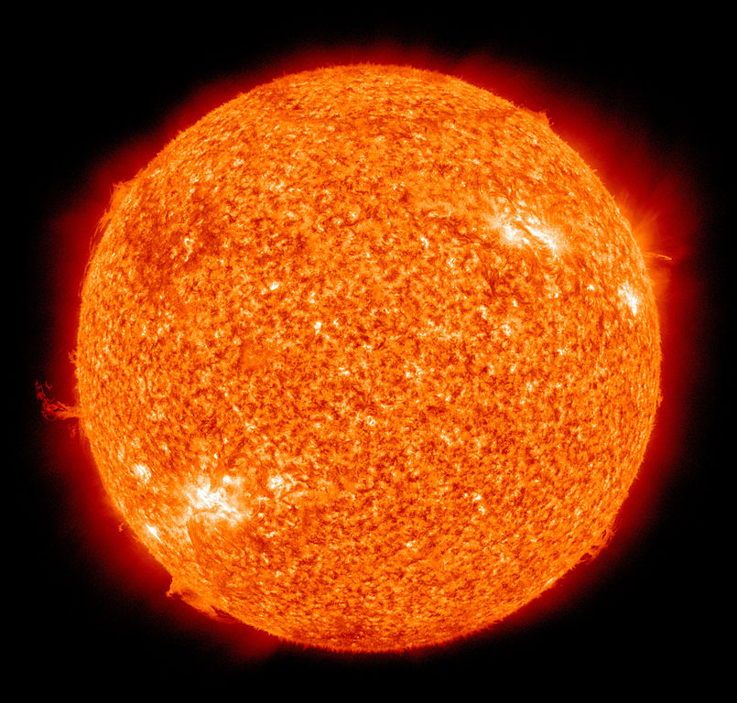
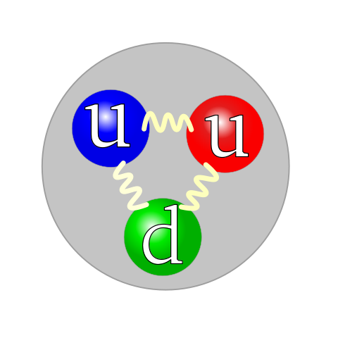
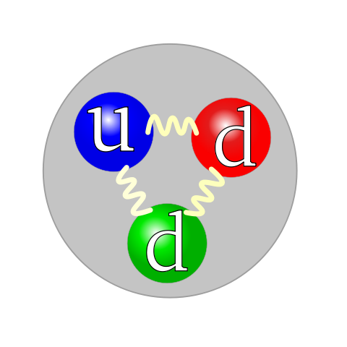
Development of the Universe

Slide 12
Before the Big Bang?
?
Beware of arguments:
The Big Bang is the beginning of the universe
All things which begin need to be caused
Therefore the universe needs to be caused
The Big Bang might NOT be the beginning
Puts God at a TIME before the beginning of time?

Slide 13
Why is there anything rather than absolutely nothing?
There must be something that just exists
Three realistic candidates:
The universe
The laws of science
God

Slide 14
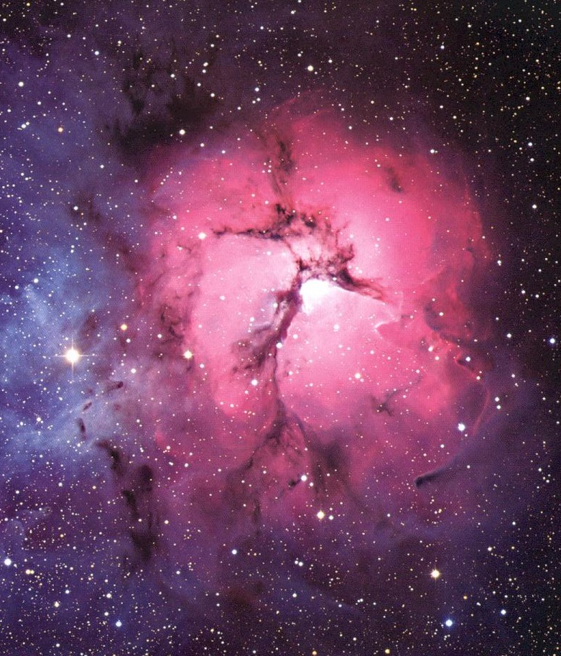
Contingency and Cosmology
Universe as a whole obeys the laws of science
Everywhere science applies, things need explaining – reasons & causes
Therefore the whole universe needs a cause
The universe
The laws of science
God

Slide 15
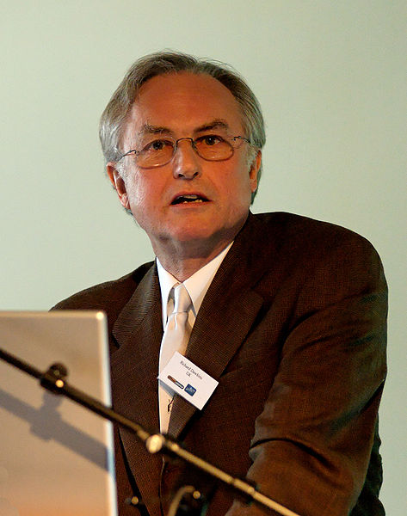
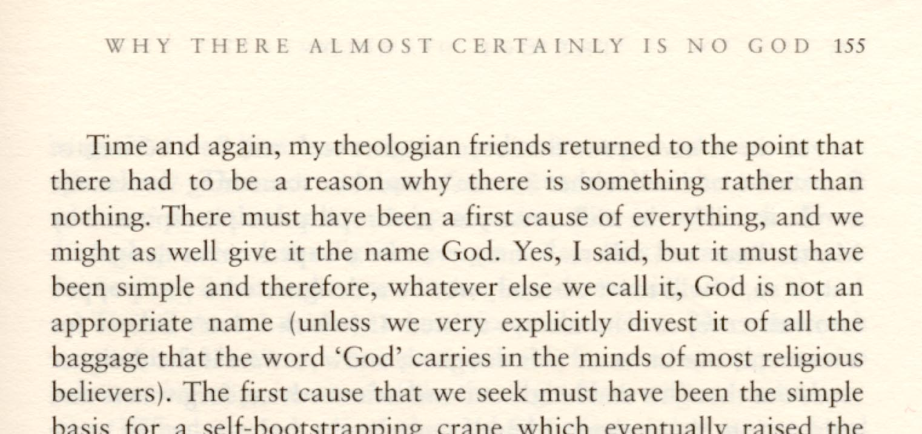
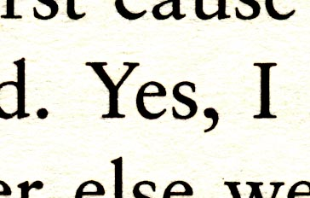
Contingency and Cosmology

Slide 16
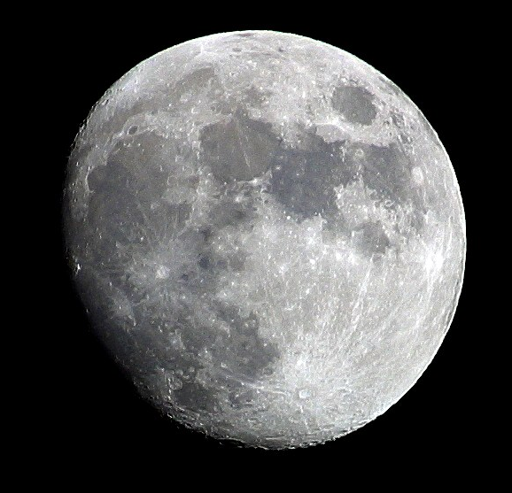
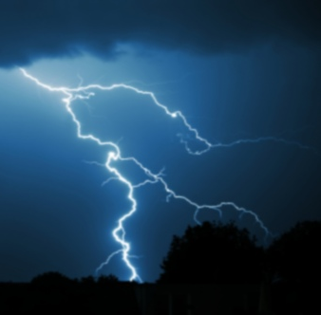
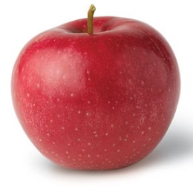
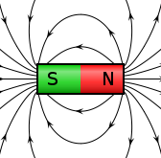
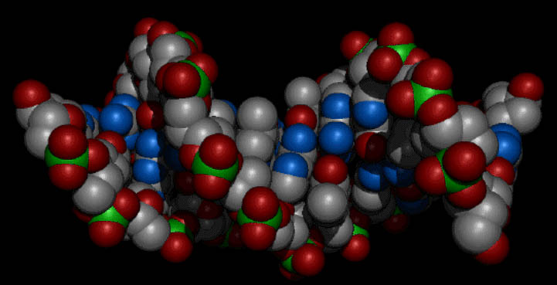
Unity of the Laws of Nature
A “Grand Unified Theory”?

Slide 17
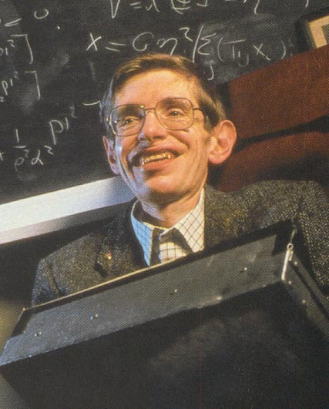
What is a “Law of Nature” anyway?
“Even if there is only one possible unified field theory, it is just a set of rules and equations. What is it that breathes fire into the equations and makes a universe for them to describe?”
Stephen Hawking,
Brief History of Time, p. 174
The universe
The laws of science
God

Slide 18
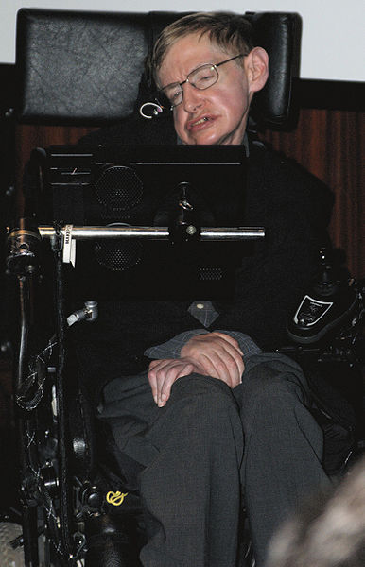
What is a “Law of Nature” anyway?
“Because there is a law like gravity, the universe can and will create itself from nothing … It is not necessary to invoke God to light the blue touch paper and set the universe going.”
Stephen Hawking and Leonard Mlodinow,
The Grand Design, p. 180

Slide 19
What is a “Law of Nature” anyway?
Non-material
Unchanging / eternal
Apply everywhere / omnipresent
Govern all that happens in the universe
Cause the universe to exist
One
The universe
The laws of science = 3. God ???

Slide 20
Conclusions
We all agree – things need explaining
So it’s all over for the atheists! (?)
If a thing needs explaining, the explanation exists
If the explanation needs explaining, got to look for a further explanation …
Even an infinite chain of contingent causes needs still a cause!

Slide 21
Conclusions
Cosmology means the universe needs explaining
So the universe is NOT the ultimate cause
It must be God or the law(s) of science
Or are they the same thing?

Slide 22
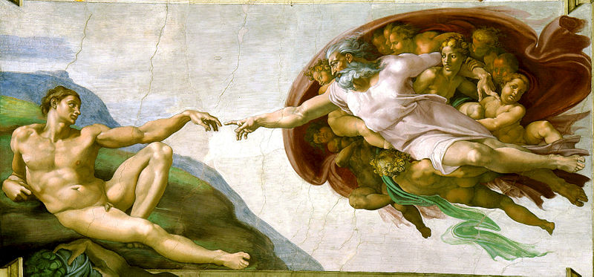
Conclusions
Is the First Cause really God?
a Personal God? – knowing and loving?
See you next week !

